Slide 1



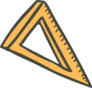



Playing with Tiny bit
Tracking
Yahboom

Slide 2


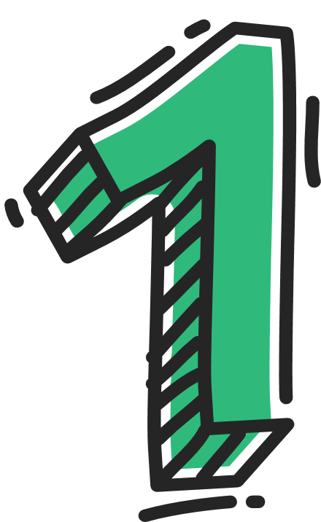




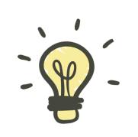
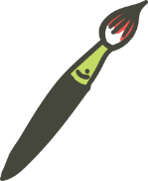
Contents
Preparation
Learning goal
Search for blocks
Combine blocks
Experimental phenomena
Yahboom

Slide 3

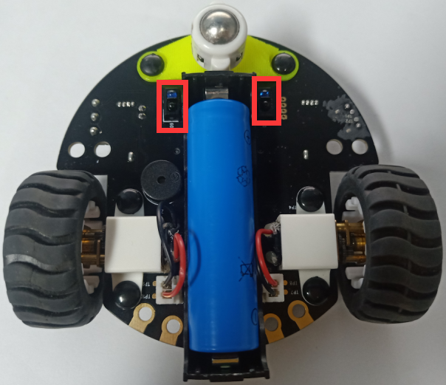
Preparation
The position of the tracking module in the robot
In the picture shown below, the tracking module with red wire frame.
Yahboom

Slide 4
Preparation
Programming method:
Mode 1 online programming: First, we need to connect the micro:bit to the computer by USB cable. The computer will pop up a USB flash drive and click on the URL in the USB flash drive: http://microbit.org/ to enter the programming interface. Add the Yahboom package: https://github.com/YahboomTechnology/Tiny-bitLib to program.
Mode 2 offline programming: We need to open the offline programming software. After the installation is complete, enter the programming interface, click【New Project】, add Yahboom package: https://github.com/YahboomTechnology/Tiny-bitLib, you can program.
Yahboom

Slide 5
Learning goal
1.Learn how to use line sensor graphically program building blocks and control motor graphically program building blocks
2.The function is realized by programming: the robot car advance along black track.
Yahboom

Slide 6

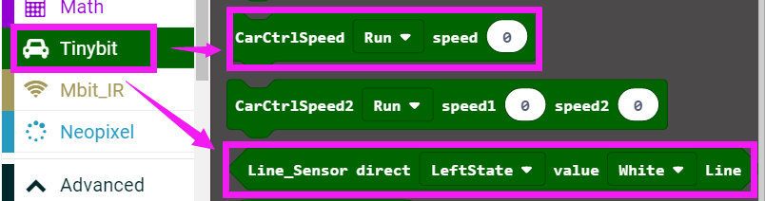
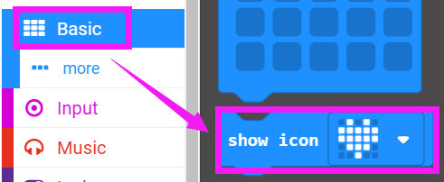
Search for block
The following is the location of the building blocks required for this programming.
Yahboom

Slide 7
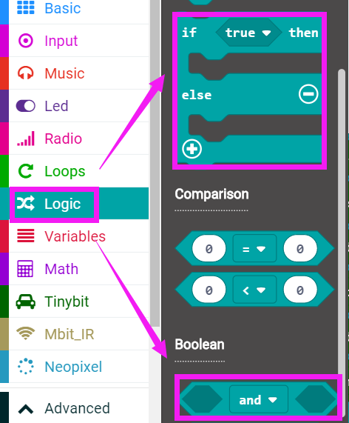
Search for block
Yahboom

Slide 8
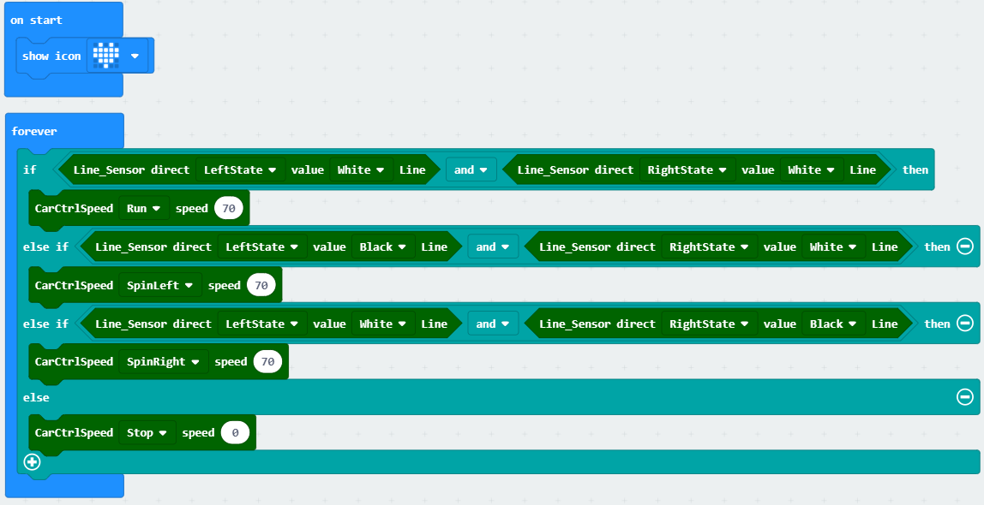
Combine block
The summary program is shown below:
Yahboom

Slide 9
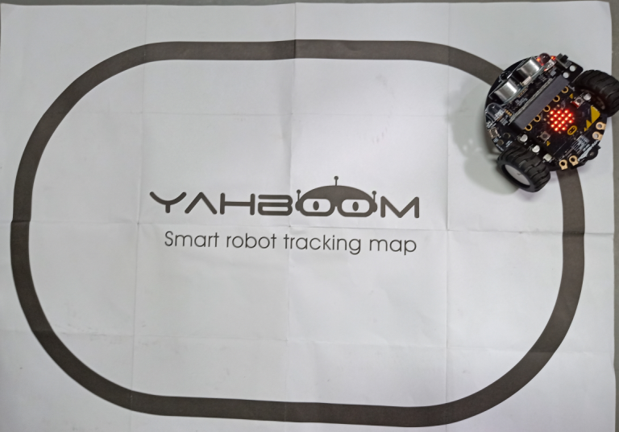
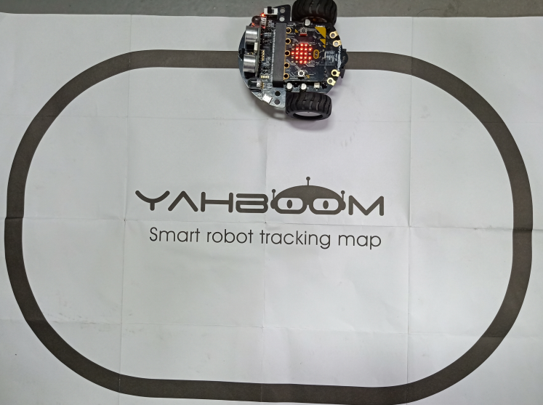
Experimental phenomena
After the prgram is downloaded, open the power of the robot car, it will advance along the black track and a heart will be display on the micro:bit dot matrix.
Yahboom

Slide 10
Inspire Creativity Embrace Innovation
Thank you!!!

